Slide 1
Solution for Thermal Fever Screening
Enterprise Business
Helena Hao 16475678528
helenahao@cmi.chinamobile.com
www.chinamobileltd.com

Slide 2
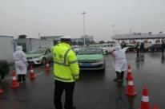
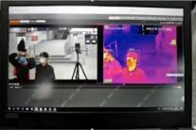
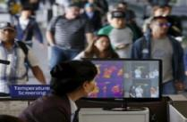
Requirement:
Monitoring and early warning, rapid and accurate detection of body temperature have become urgent needs for epidemic prevention
Challenge
Requirement
Scenario
Manual body temperature measurement
Low detection efficiency: it consumes a lot of manpower and higher risk due to people queuing.
Disputes: targeted temperature measurement can easily cause passenger resistance.
Lack of early warning capabilities: front-end inspector can conduct only blind spot checks.
No traceability : cannot record the all passenger and their temperature for follow-up afterwards.
Contactless and Accurate
Important transportation hub: airports, train stations, bus stations, subway stations, ferry ports, etc.
Key traffic place: toll gate, service zone, gas station, checkpoints
Business and public area: office lobby, shared office, shopping malls, hotels, restaurants, etc.
Other: hospitals, schools, embassies, government agencies
Multi-person Detection
Quick Detection
Real-time Recording
Facial recognition (Opt)
One Person One Profile
Notes:
Epidemic monitoring and early warning, rapid and accurate detection of body temperature have become urgent needs for epidemic prevention and control and to ensure transportation services

Slide 3


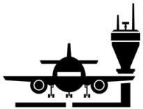





Applied Environment
Airport
Ports
Terminals
Customs
Campus
Malls
Hospital
Factory

Slide 4


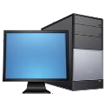

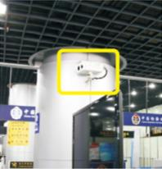
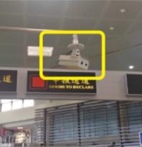
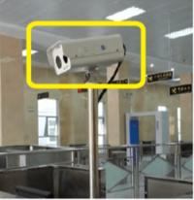
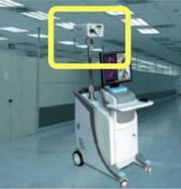
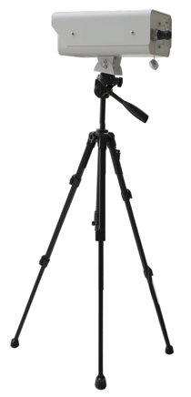
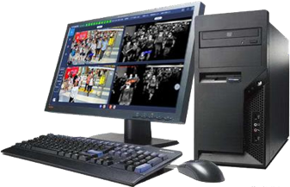

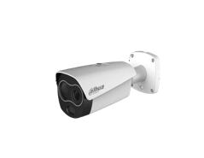

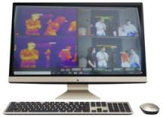

Deployment
Blackbody
The camera screens people's body temperature and indentify those abnormals.
Temp Calibration
Temp Detection
People passing by or entering temperature screening zone.
Alarm will sent to control station when abnormal temperature detected.
Wall Mount
Pendant Mount
Pole Mount
Mobile Cart

Slide 5

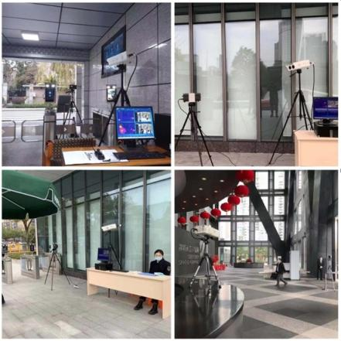
Deployment
Factory Entrance
Industry Campus Entrance
Condo Entrance
Office Building Lobby

Slide 6

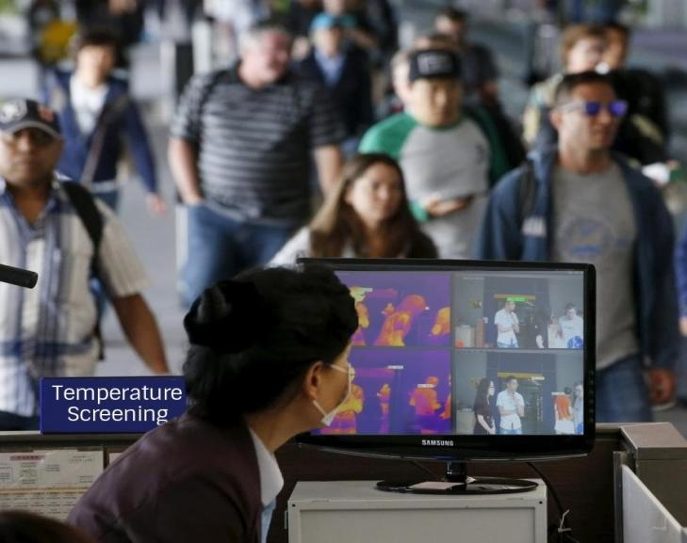


Contactless & Real-time
Temperature Screening System

Slide 7

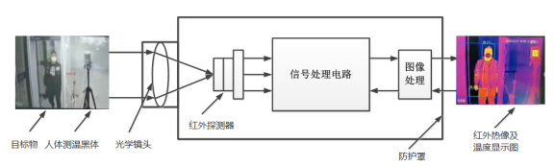
Measurement Principle
The features are non-contact, fast, and no risk to the measuring person. It can be easily deployed in crowded public places. It is efficient and safe for preliminary screening of abnormal temperature. Temperature calibration (black body) improves the accuracy of measurement.
Thermal detection
All material temperatures are continuously radiate electromagnetic waves. The thermal imaging camera collects the infrared radiation energy emitted by the measured object and passes the temperature measurement algorithm and the black body temperature calibration to process the target energy Establish accurate correspondence with temperature to achieve human body temperature measurement function.
Black body : all incident electromagnetic waves are absorbed, neither reflected nor transmitted, as a standard object. Infrared thermal imaging cameras will be affected by external factors during long-term use and cause errors. Therefore, the black body needs to be calibrated (as a standard object) to improve the stability in different environments.

Slide 8
Accuracy ±0.3℃ with Auto calibration
远距离大范围
异常体温实时监测
精准、高效、低风险
适应多种场合，可追溯
Features and advantages：
Contactless Temperature Screening based on precision thermal camera & auto calibration black-body.
Key Features
Advantage
Contactless rapid temperature screening, real-time measurement to avoid cross infection;
Network thermal camera (384*288 pixel) and network full color camera (1080P);
Real-time dynamic thermal image, multiple targets measurement;
Auto calibration, build-in black-body adjustment and high precision sensor;
Bi-spectrum imaging, fixed mounting and movable cart optional;
Measurement accuracy: ±0.3℃;
High Accuracy：±0.3℃
High Efficiency：long-rang and large-scale detection;
Low Risk： contactless and rapid screening, less risky of infection；
Easy to use：quick deployment, and adapt to multiple scenarios;
Info Recoding：record video and temp info, easy to extend to facial recognition and contact tracing

Slide 9
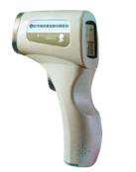

System Architecture
Blackbody
The camera screens people's body temperature and indentify those abnormals.
Temp Calibration
Temp Detection
People passing by or entering temperature screening zone.
Alarm will sent to control station when abnormal temperature detected.

Slide 10
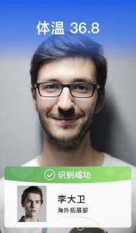
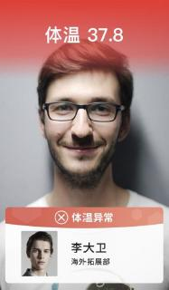
Screenshots of Face Recognition Terminal
Body temperature
36.8 ℃
Body temperature
36.8 ℃
Authenticated
Abnormal body
temperature
David
ID: 2201
David
ID: 2201

Slide 11




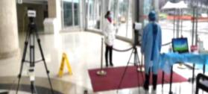
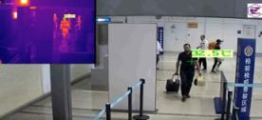
Solution 1: local deployment of thermal camera
Scenarios:
Temporary control of transportation hubs, supermarket chains, hospitals, schools, governments and industrial campus
+
+
+
01
Equipment list：
1 thermal camera + 1 blackbody + 2 tripods + 1 computer (temperature measurement software installed)
Thermal CAM
Black Body
Tripod*2
Computer
02
The thermal imaging camera is directly facing the entrance, and the black body is facing the camera.
After installing the application software on the computer, connect to local network to monitor the personnel temperature in real time.
Thermal CAM
Black Body
Computer
03
If the temperature exceeds the standard temperature, the sound or light alarm can be activated through the built-in light or horn of the camera.
For the fevered person who is initially screened by the camera, the thermometer can be used for a second retest as needed.
部署示意图
Deployment
04
Features:
The result can be automatically compensated according to environmental parameters, and accuracy：± 0.3 ℃;
Can set detection area, support point, line, frame temperature measurement;
Demo

Slide 12
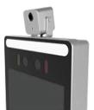


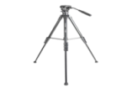
Solution 2: Thermal imaging module
Scenarios:
various agencies, institutions, schools, etc.
01
Solution A：high-precision thermal imaging module + face recognition machine
High-precision thermal imaging modules can detect infrared images of people entering and leaving and collect personnel temperature;
Temperature is displayed on the face recognition machine, and an alarm prompt is given for the abnormal body temperature, and the relevant personnel are notified to perform a review.
In the future phase, simultaneously implements face recognition and temperature monitoring. Display body temperature on the screen simultaneously after face recognition.
Demo 1
02
Solution B： High-precision thermal imaging module + tripod + monitoring computer
The module is placed on a tripod and connected to a monitoring computer through a serial port.
Detecting infrared images of people entering and leaving and collect personnel temperature;
The temperature is displayed on the monitoring computer, and an alarm prompt is given for the abnormal temperature, and the relevant person is notified to review.
Accuracy: measurement distance 0.5 meters, ± 0.5 degrees
Demo 2

Slide 13






Solution 3: Centralized Camera network
Scenarios:
transportation hubs, schools of all levels, etc..
Video Management Software (VMS)
In response to the needs of multi-level management, remote decision-making, and statistical analysis of epidemic prevention and temperature measurement.
upload the related information to the cloud platform for centralized management e.g remote viewing and decision-making reference.
Able to store and trace back the measurement data and statistics analysis.
Temperature Calibration
Black-body
Campus
Thermal Camera – Type I
Advantages:
The results and alarms support local display, and support cloud display and storage.
The system supports multi-level cloud architecture and distributed deployment, supports the Internet and private networks and cloud platform.
Early warning management: adopting face capture recognition technology to measure temperature and realize whether the target face is wearing a face mask, lock over-temperature target, dynamic alarm, support voice live broadcast.
Supports API integration with 3rd party platform, providing face photos and body temperature.
Temperature Calibration
Customs
Thermal Camera – Type II
Temperature Calibration
NVR
Black-body
Shopping mall
Thermal Camera – Type I
Temperature Calibration
POE Switcher
Others
Thermal Camera – Type II
Device
Network
Platform

Slide 14










Backup uplink solution by mobile network
Non-contact Video
Thermal Detection & Alarm
Firewall
4G
Internet
Switch
4G
Video Server
4G
Type I & II
Thermal Cam
4G
VMS
TV Wall
4G

Slide 15
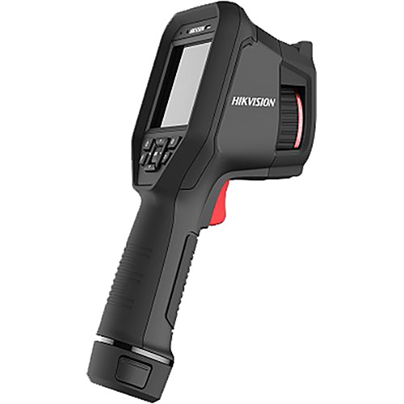
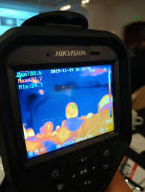
Solution 4: Highend Handhald Thermal Camera
Scenarios:
Enterprise,Large Office, Outdoor environment
Hikvision DS-2TP23-10VM/W
384× 288 resolution(thermal),and 1080Presolution (optical)
DDE (Digital Detail Enhancement) technique
3D DNR, adaptive AGC (Automatic Gain Control)
640×480 resolution 3.5’’ LCD touch display
Built-in rechargeable Li-ion battery
Up to fourhours continuous running
Highlight
Support maximum scan 3people/second
Accuracy ±0.5° C
Not support face detection
Central Management Via Hikvision software
Network connection, support hik-tharmal apps on tablet PC
Sensitive environment impact
Best Detect Range=1-2.5M
.

Slide 16
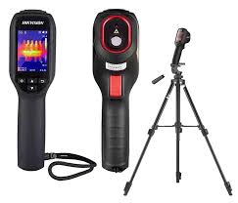
Solution 5: Lowend Handhald Thermal Camera
Scenarios:
SMB,retail store
Hikvision DS-2TP31B-3AUF
High sensitivity sensor with 160 x 120 resolution
High quality 320 x 240 resolution 2.4'' LCD display
Up to 4 palettes
Wide temperature measurement range: -20 - 550° C
High temperature measurement accuracy: Up to ±0.5° C, ±0.5%
Long-distance laser light supplement for thermography targets
Built-in rechargeable Li-ion battery
Up to 8 hours continuous operatio
Best Detect Range=1-2.5M
Not support any video output
Must for indoor environment
.

Slide 17
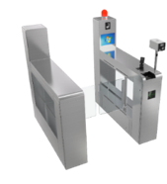
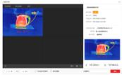
Solution 4: Temperature measurement gate
Scenarios:
internal access control in enterprises, schools, factories, etc., and scenes of gate passages such as subways and stations.
Solution A:
Integrated temperature measurement
personnel gate channel
Solution:
Before entering, perform a temperature test, normally open the gate, and make an alarm.
For abnormal situations, the staff intervened and tested again to control the personnel
+
Integrated temperature measurement personnel gate channel
Controlling Platform
Accuracy : ± 0.3 ℃ range: 30-45 ℃

Slide 18
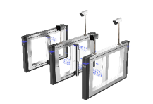


Temperature measurement gate
Scenarios:
transportation hubs, schools of all levels, etc..
Solution B：
Thermal Camera + Blackbody + Channel Gate
Deployment and use:
The thermal imaging camera and the black body are installed in the gate passage, and the access terminal of the camera is connected to the gate controller.
When the temperature is normal, the gate will be released. When the temperature is abnormal, the gate will not be opened. At the same time, the camera can alarm and the staff will perform manual retesting.
Optional intelligent video surveillance integrated body to store video recordings and temperature measurement records.
At the same time, it can choose to cooperate with the face recognition gate to achieve dual control of temperature measurement passage and face brush passage.
+
+
Thermal CAM
Black Body
Gate

Slide 19
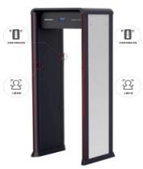
Security Gate Solution
Scenarios:
Major transportation hubs such as subways, stations, airports
Module A： Integrated body temperature and security inspection door
body temperature and security inspection door
Solution：
In and out personnel pass the security gate to achieve body temperature monitoring and screening for carrying metal objects.
Those who exceed the set temperature or carry prohibited objects can link up with sound and light alarm at the security gate.
Face capture of people passing through security gates, with a success rate of more than 98%.
Accuracy: ± 0.5 ℃ measurement distance: 0.3-3m
Facial recognition Sensor

Slide 20



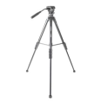
Security Gate Solution
Scenarios:
Major transportation hubs such as subways, stations, airports
Module B： Thermal camera + black body + tripod + security door
Solution:
The thermal imaging camera is mounted on the security door, and the black body is mounted on a tripod facing the Entry and exit
Through the security gate to achieve temperature monitoring and screening of metal objects
People who exceed the set temperature and those who carry prohibited objects such as metal can report the alarm
On-site security personnel can check the temperature report and follow up.
Thermal CAM+ Black Body+ Tripod+ security door
Accuracy: ± 0.5 ℃ measurement distance: 0.3-3m

Slide 21
Competitive Advantages
1. Government & Bank High-level Security Standard
7. High-Availability Server Set
2. Large-Scale System
by Awards Winning Technologies
Competitive
Advantages
3. On-premise Video Server
without System Backdoor
6. Highly-Reliable US Chipset
5. Self owned server with data security
and privacy
4. All-In-One Video & PTT Server

Slide 22
Key Takeaway
High demand of body temperature screening solution
Accuracy ± 0.3 ℃ with high screening efficiency
Customized solutions to adapt specific requirements
Due to Shortage of supply, delivery schedule need to confirm after ordering*

Slide 23
Q:Can the thermographic fever screening camera be installed outdoors?
Q:Does the camera recognize the face for temperature measurement
Q:How long can I use the fever
screening function after the camera
is turned on?
A: 5 minutes after the handheld camera is turned on, 30 minutes after the bullet / turret camera is turned on.
A: Outdoor wind and sun can easily affect the body surface temperature and the working status of the camera, which results in a deviation between the measured body surface temperature and the actual body temperature.
From the perspective of ensure the accuracy, we strongly recommended the solutions used indoors
A: The camera recognizes faces when screening. It supports up to 10 faces. But still we recommended to carry out temperature measurement in order.
Q:Will other heat sources (such as tea cups, kettles, etc.) cause false alarms?
Q:Can the accuracy of thermographic fever screening camera reach 0.1 ℃?
Q：Is thermographic handheld camera support alarm automatically? Or is it support link with VMS
A: Thermographic handheld camera support value character turn red automatically when detect temperature-exception, but no other method to notice. Not support link with VMS
A: No. Now, cameras with accuracy higher than 0.5 require black-body online real-time calibration and intelligent compensation. The accuracy of black body is currently plus or minus 0.2, and it is impossible to achieve 0.1. High-precision accuracy solutions right now are all 0.3
A: The cameras are able to use face recognition technology, so other heat sources will not cause false alarms.

Slide 24
Thank You

